Slide 1
Week 1

Slide 2
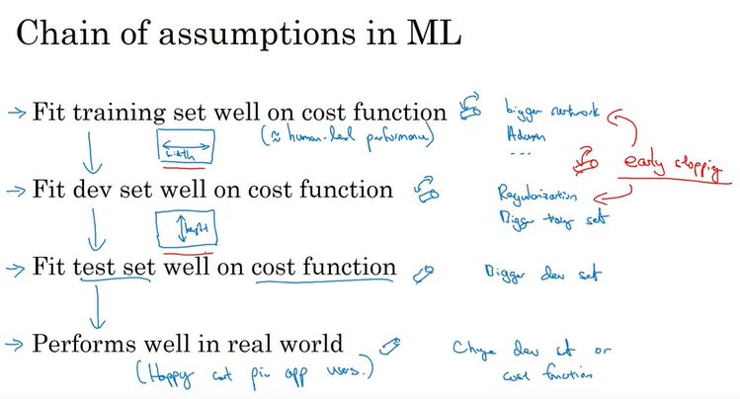

Slide 3
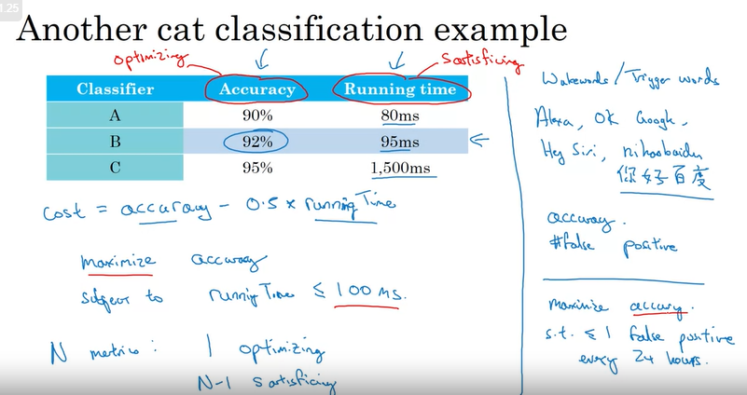

Slide 4
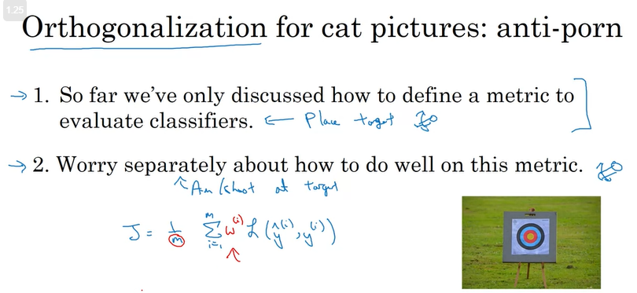

Slide 5
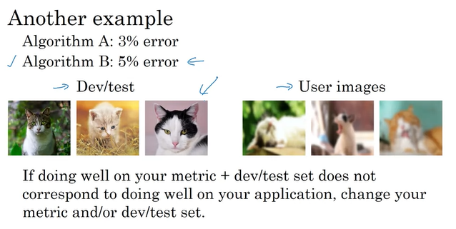

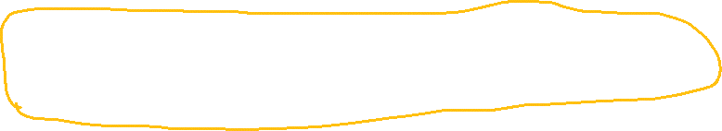

Slide 6
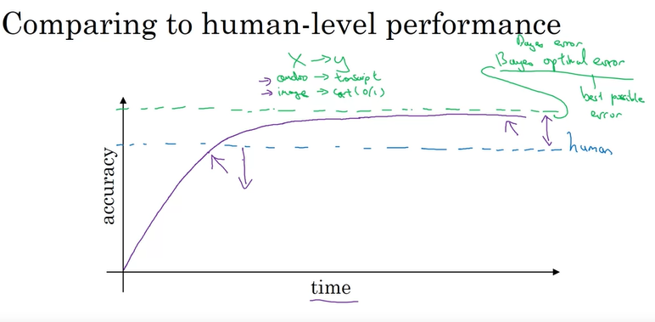
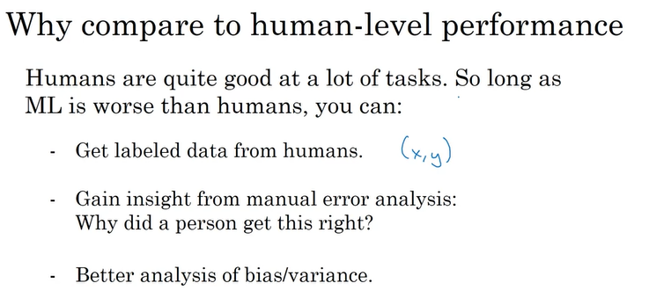

Slide 7
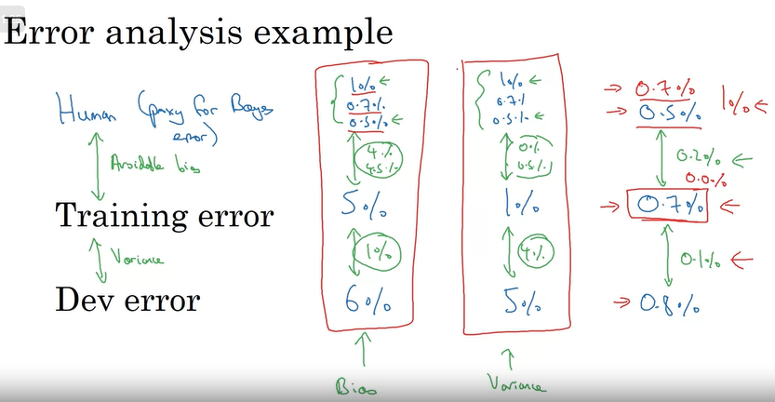

Slide 8
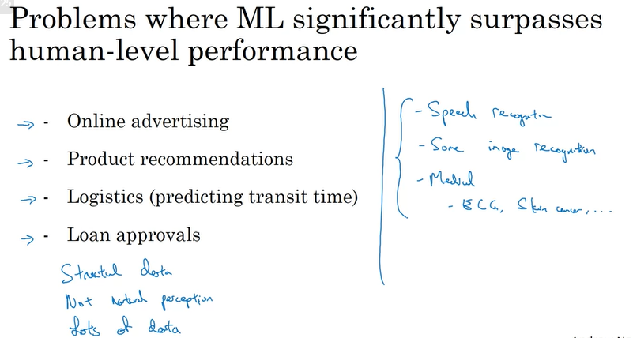

Slide 9
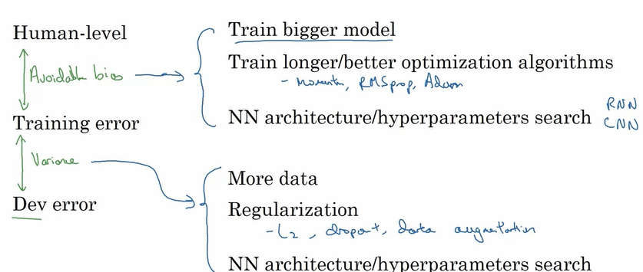

Slide 10
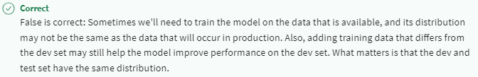
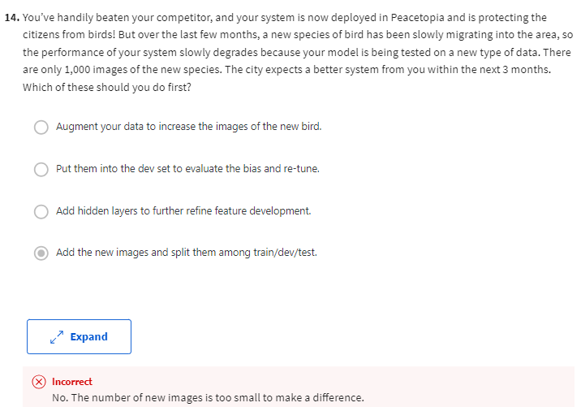

Slide 11
Week 2

Slide 12
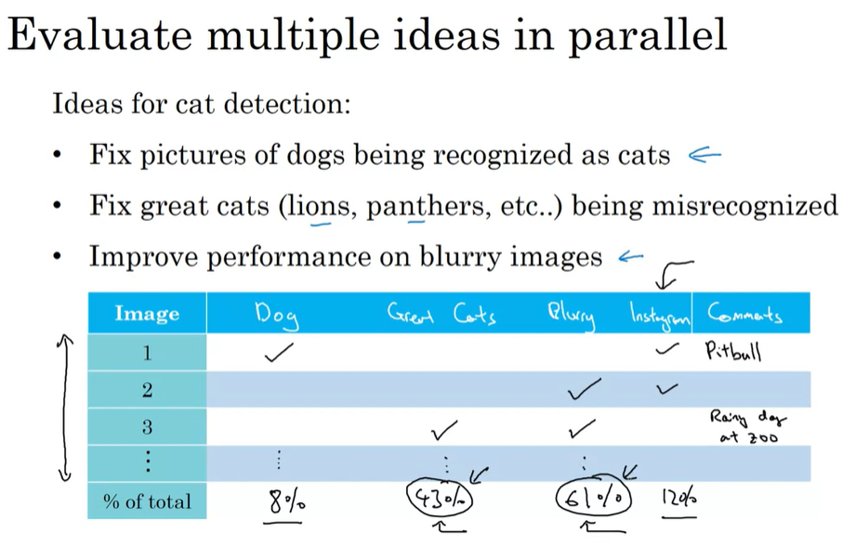

Error Analysis
Incorrect instances

Slide 13
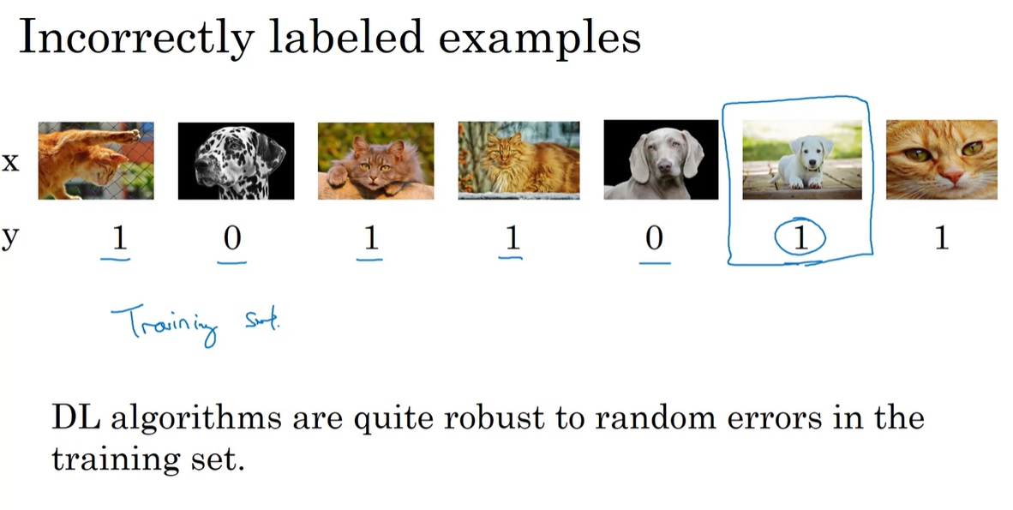

Slide 14
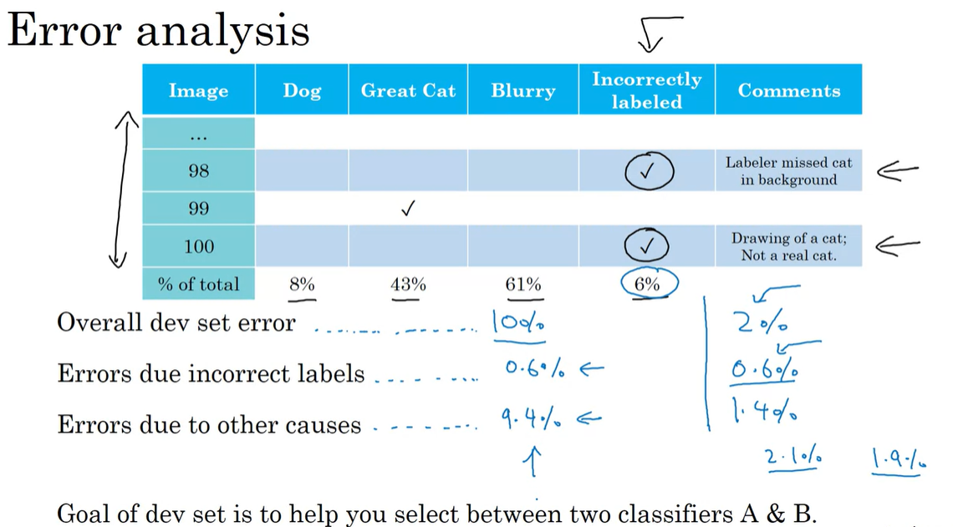

Slide 15
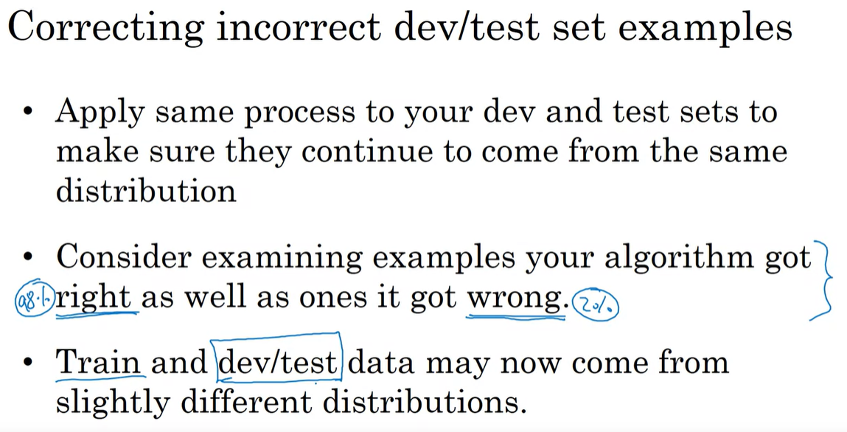

Slide 16
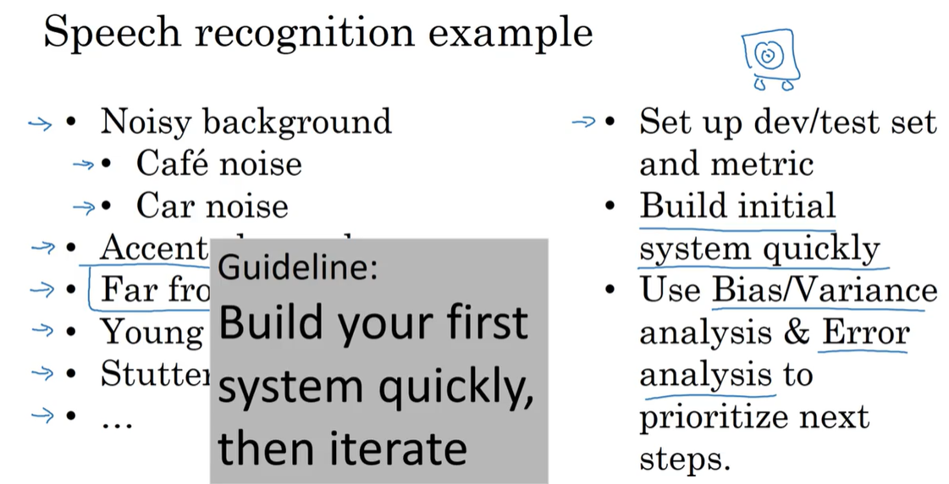
Start quickly, don’t over think

Slide 17
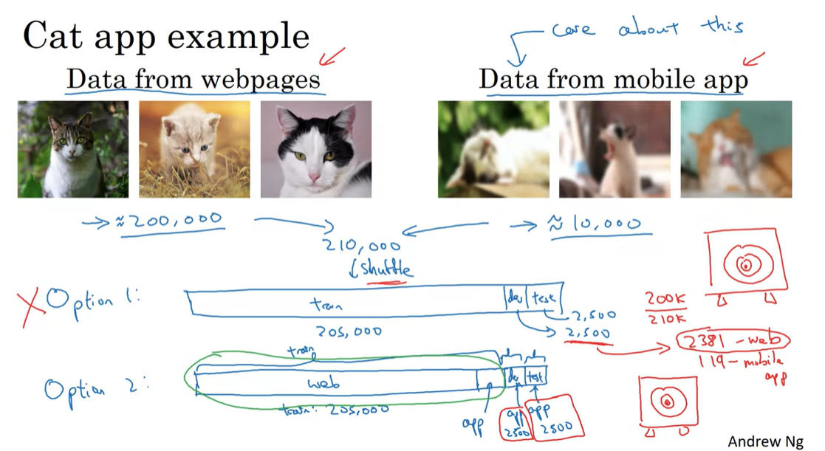

Slide 18
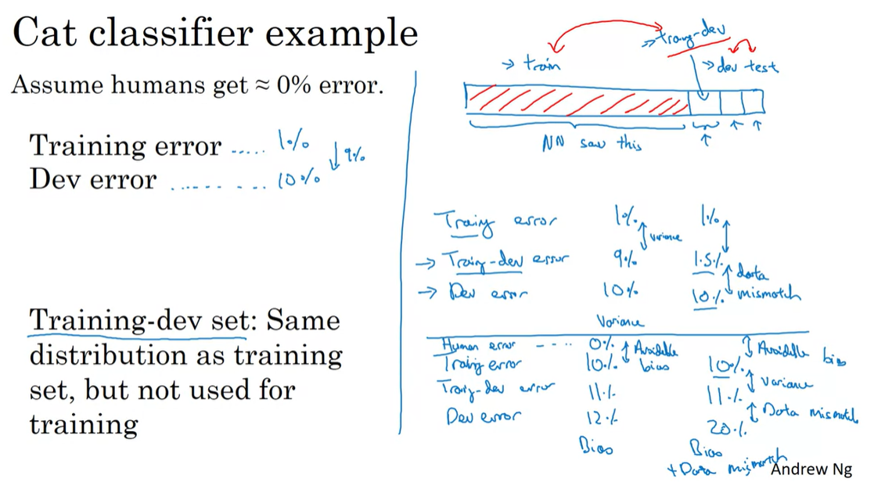

Slide 19
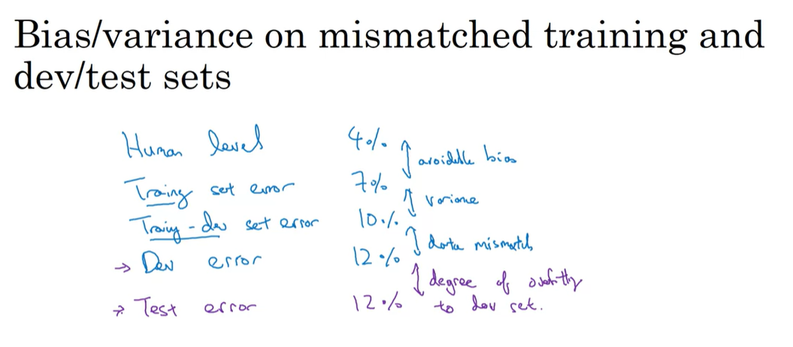

Slide 20
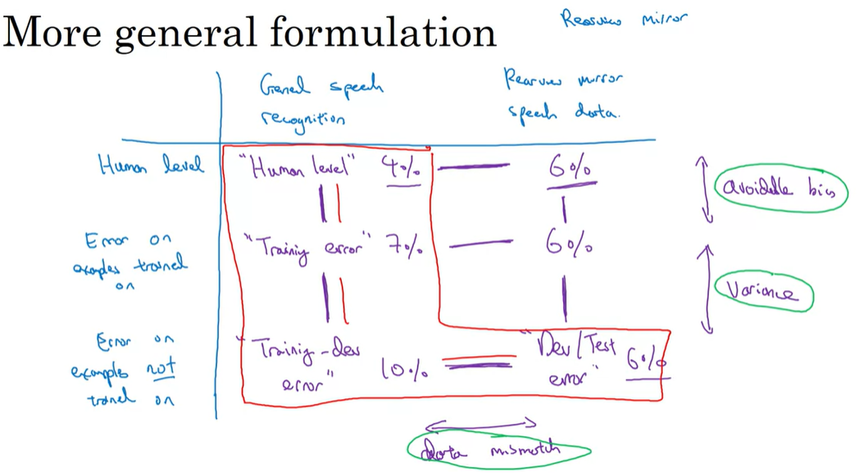

Slide 21
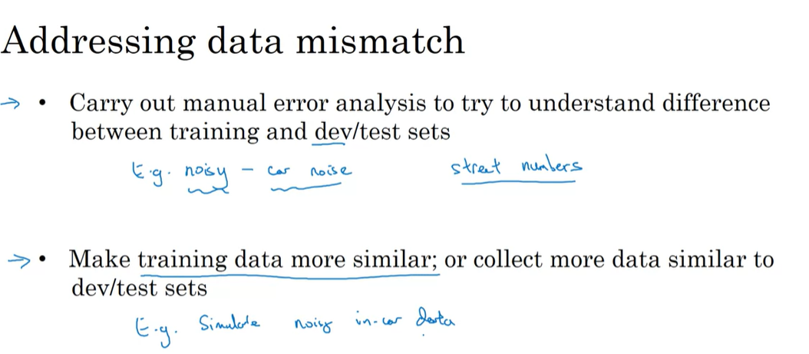

Slide 22
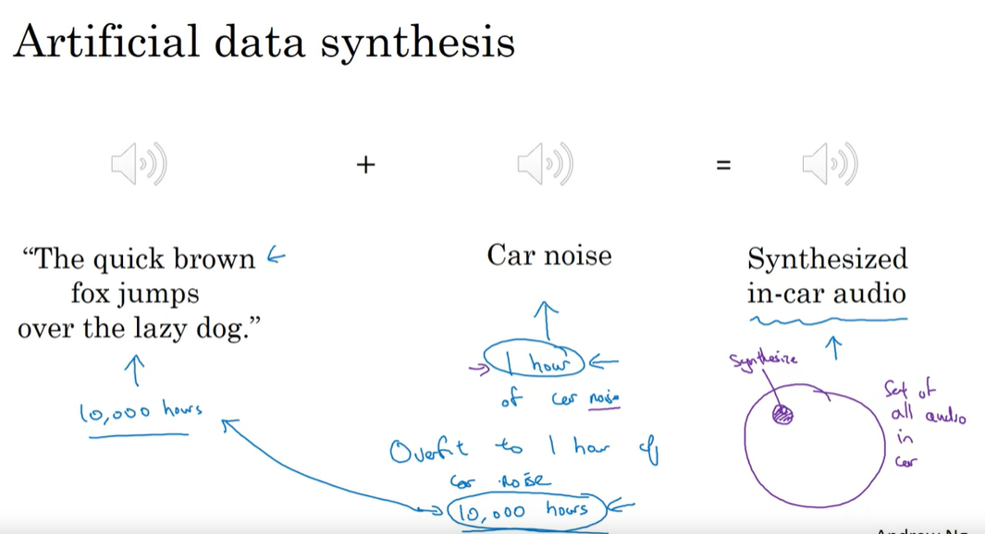
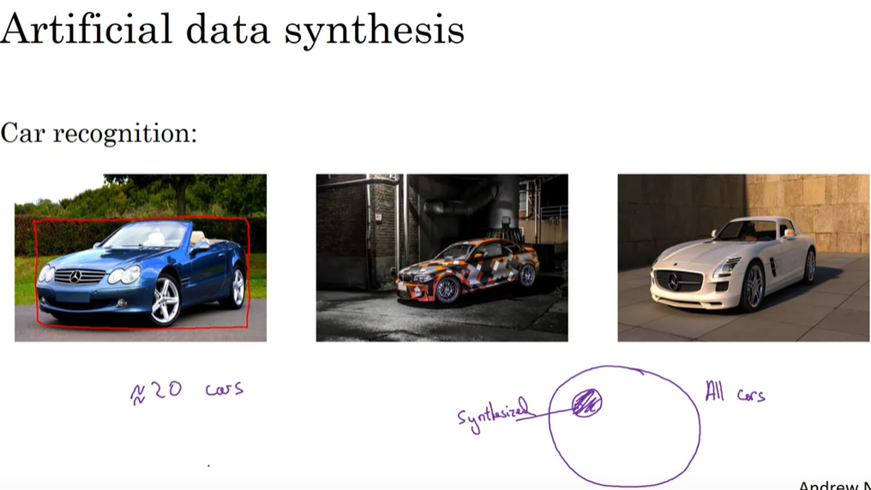

Slide 23
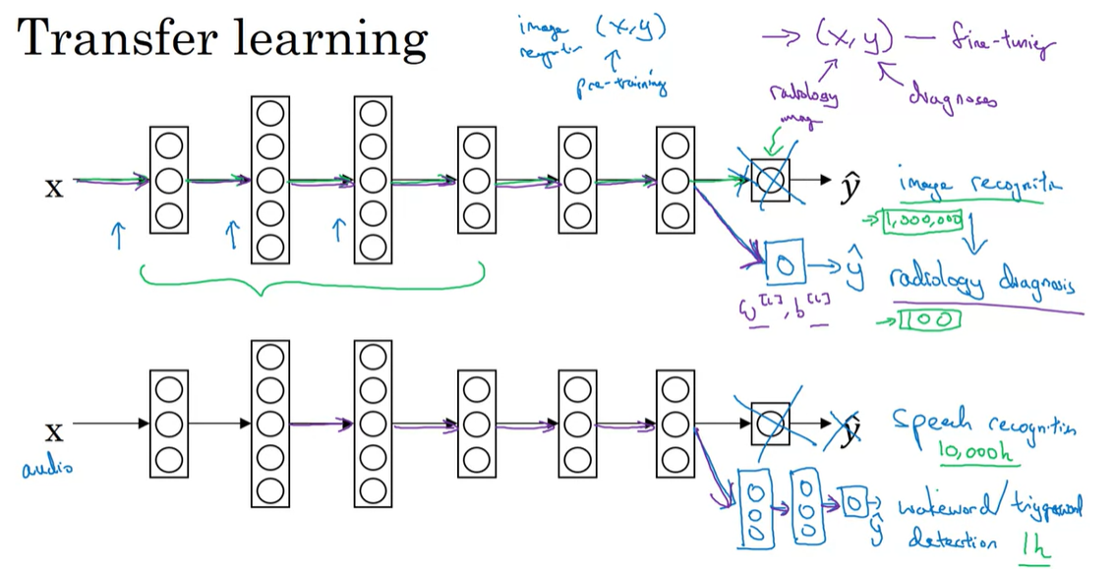

Slide 24
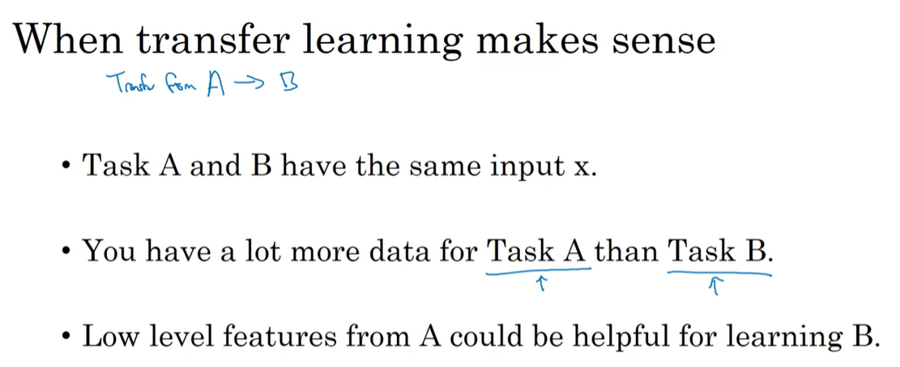

Slide 25
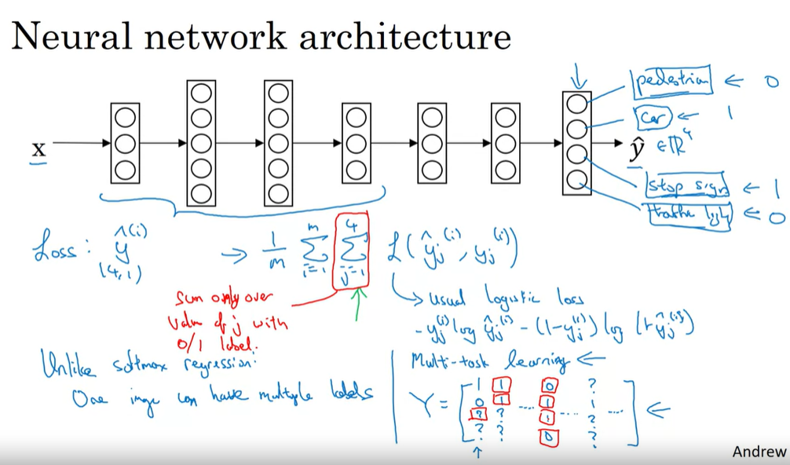

Slide 26
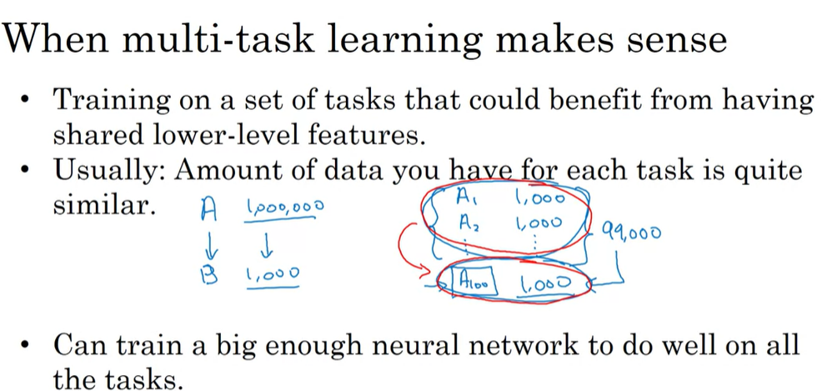
Much less often used then transfer learning

Slide 27
As a Multi-Class Classification Task:
If the goal is to classify each image into a single category out of a set of predefined categories (e.g., stop sign, pedestrian crossing sign, construction ahead sign, red light, green light), and each image contains only one object of interest, this is a multi-class classification problem. The model's task is to correctly label each image with the one category that the primary object in the image belongs to.
As a Multi-Task Learning Task:
If the goal is to perform several different detection tasks within the same image, such as simultaneously detecting and classifying the type of road sign as well as the state of the traffic light, it becomes a multi-task learning problem. Here, the model would have shared layers to learn general features about road signs and traffic signals, but separate output layers for each task—one for classifying the type of road sign and another for identifying the color of the traffic light.
In practice, self-driving cars need to detect and interpret multiple objects in a single frame, and the presence of one object does not exclude the presence of another (e.g., a stop sign and a red traffic light might appear in the same image). Therefore, this scenario is typically best approached as a multi-task learning problem, allowing the model to leverage shared features across the tasks while providing separate predictions for each relevant object or signal in the scene.

Slide 28
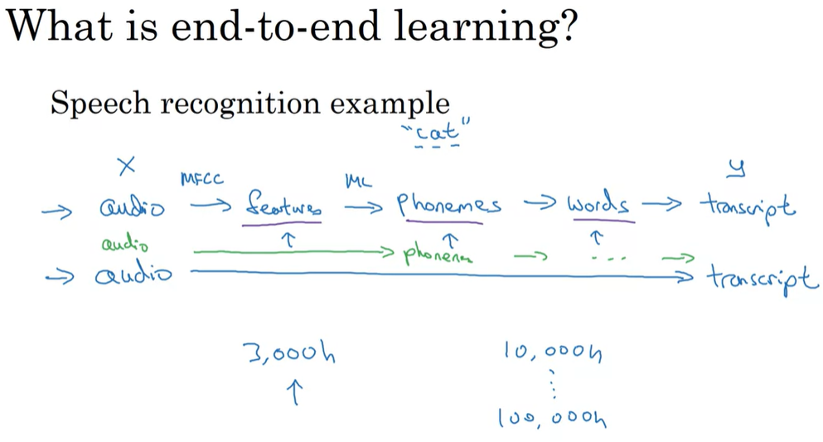

Slide 29
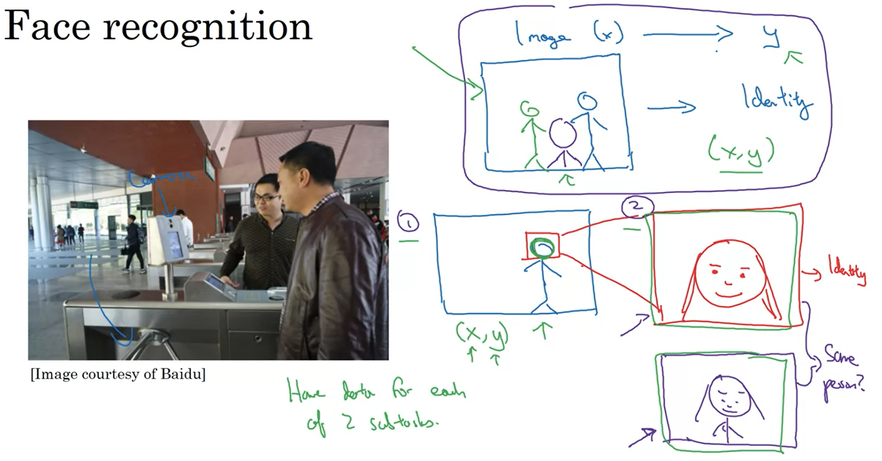

Slide 30
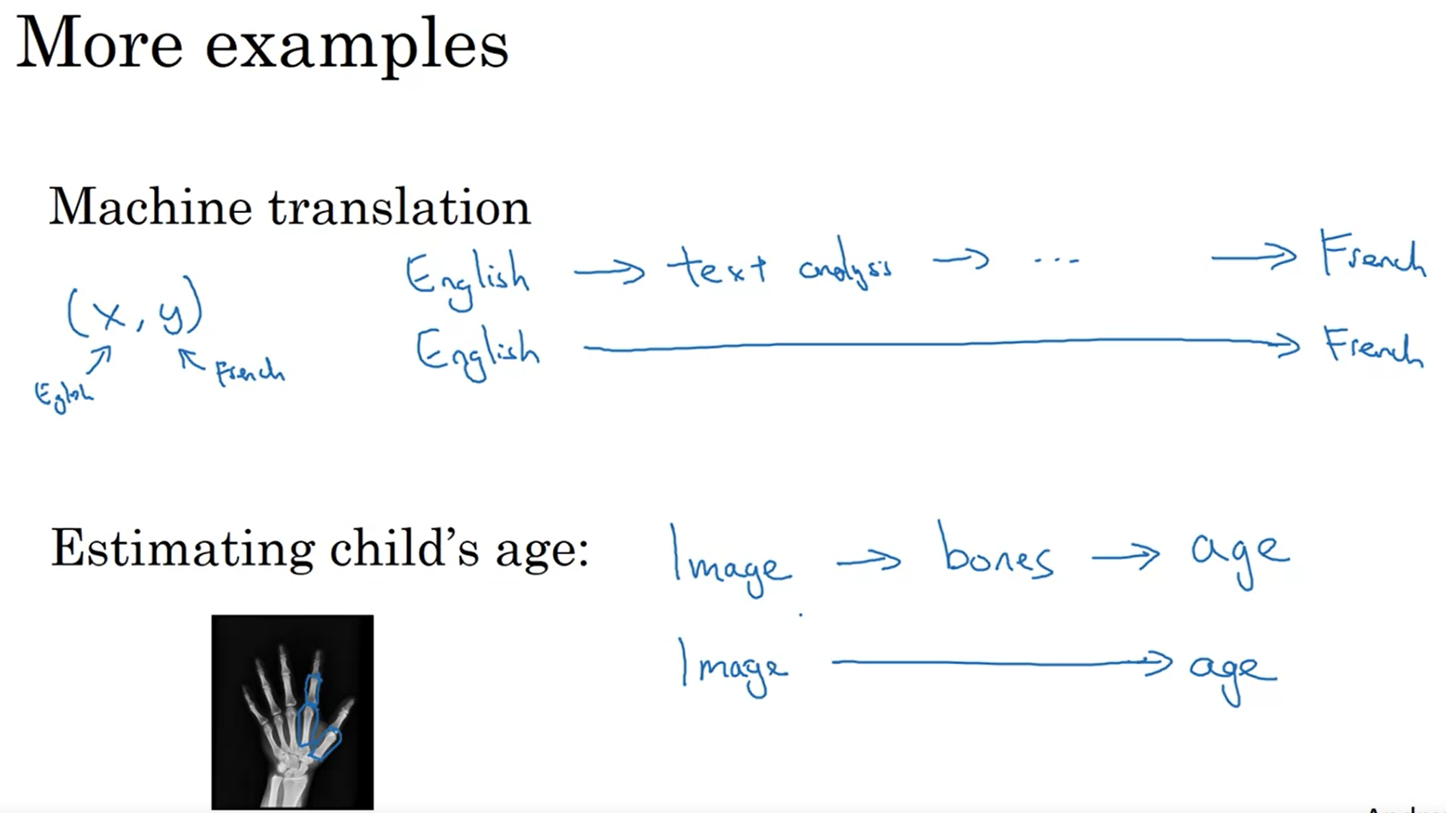

Slide 31
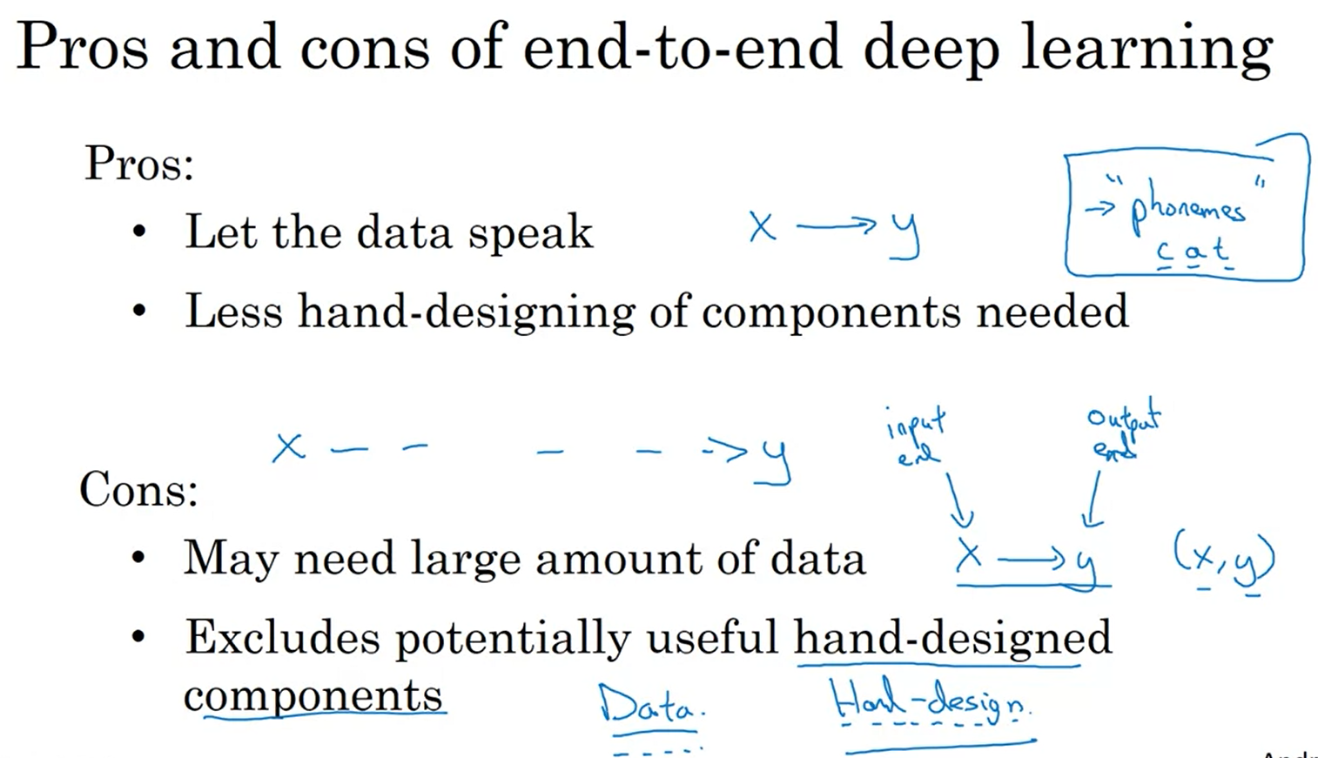

Slide 32
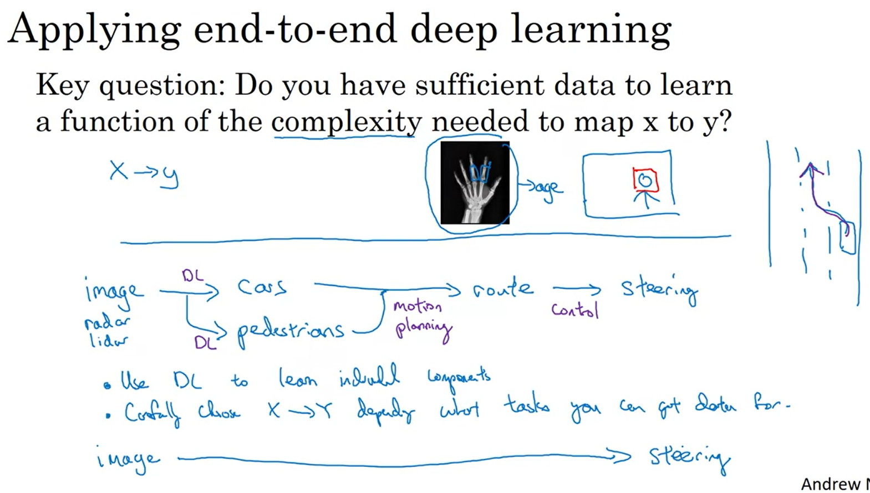

Slide 33
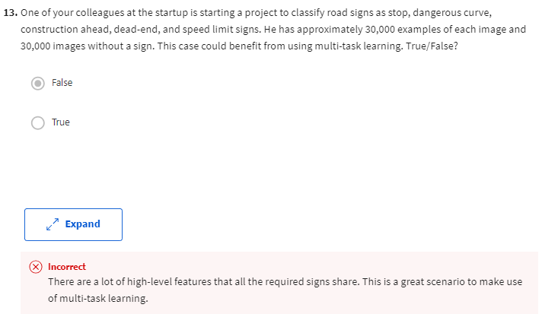
Is it just a multi-class classification task: classify the sign?

Slide 34
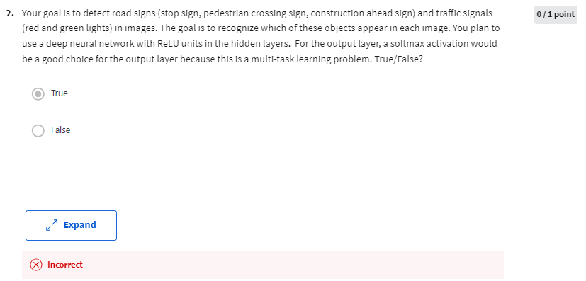
softmax is appropriate for mutually exclusive categories
if one image could have both a sign and a traffic light, the use of softmax would not be appropriate, and the system would not be a multi-task learning problem but a multi-label classification problem. The correct statement should acknowledge the need for a multi-label approach, possibly using sigmoid activations for each class output.

